Slide 1
Polygyny and polyandry
Name:
Professor:
Course:
Date:

Slide 2
Introduction
Polygamy is one of the most debated issues today.
Polygamy can occur in the form of polygyny and polyandry (Thobejane and Flora).
Polygyny is when a man is married to more than one wife.
Polyandry is when a woman is married to more than one man.

Slide 3
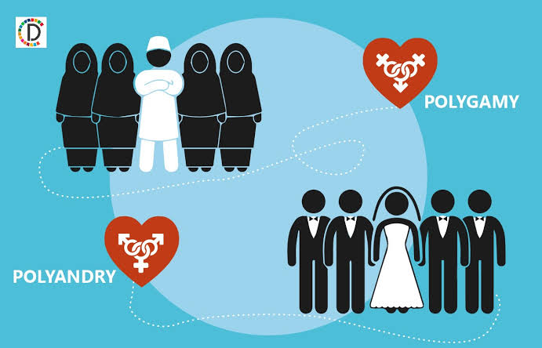
Introduction Cont’
Polygyny is most common than polyandry.

Slide 4
Overview of Polygamous Marriages
Polygamy is deeply rooted in the lifestyles of our ancestors, thousands of years ago.
Polygamy is a form of marriage where a man or a woman has more than one spouse.
Polyandry and polygyny marriages around the globe has become a social issue, and a major influence on their lifestyles.

Slide 5
Polygamous Marriages in the United States
Polygamous marriages is a sociopolitical issue in the United States in the mid-19th century.
In the United States, polygamous marriages have been discussed in the context of Mormon religion.
Bradley offers a clear account of the events of July 26, 1953, when polygamists living in the small town of Short Creek were raided and removed from their homes.

Slide 6
Polygamous Marriages in the United States
The implementation of federal laws prohibiting polyandry and polygyny had significant effects because of the severe social disruptions (Bradley).
Raids of a polygamous community were influenced by many factors, including child abuse, technological advancements, underage marriages, and media examination.
Polygamous communities were excluded from the mainstream society leading to creased poverty levels, lack of education, and inequalities (Jacobson and Lara).

Slide 7
Effects of Polygyny and polyandry
According to Wayermann, one of the major problems associated with polygamous marriages is violation of children rights, including rape, abandonment, underage marriage, and kidnapping.
Another effect is increased taxation of people to feed leaders' pockets.

Slide 8
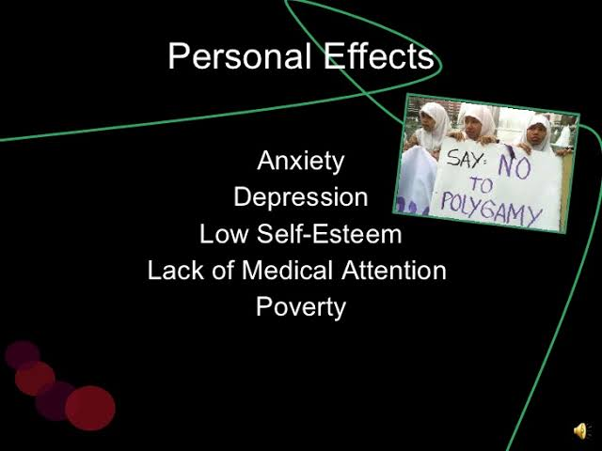
Effects of Polygyny and polyandry
Other effects of polygamy to women and children can be depression, low self-esteem, and anxiety.

Slide 9
Polygamy in the United States Today
Having multiple spouses today can be seen as a minor offense that is not punishable by jail time.
For example, the state of Utah decriminalized marriage of more than one spouse, lowering the punishment to similar to traffic summons (Hauser).
In a Gallup poll in 2020, one out of five U.S. adults believed that polygamy is morally acceptable.
The position of many people regarding polygamy has changed in the recent years because of increased acceptance of homosexuality.

Slide 10
Conclusion
Polygyny and polyandry are polygamous marriages occurring in the United States even today.
Although these laws are not easily executed, they have helped establish a norm that marrying many spouses is a moral problem.
People's points of view continue to change regarding this issue due to technology advances, changing religious doctrines, political ideologies, and acceptance of homosexuality.

Slide 11
Works cited
Bartholomew, G. W. “Recognition of polygamous marriages in America.” The International and Comparative Law Quarterly 13.3 (1964): 1022-1075.
Bradley, Martha Sonntag. Kidnapped from That Land: The Government Raids on The Short Creek Polygamists. University of Utah Press. (1993).
Hauser, Christine. Utah Lowers Penalty for Polygamy, No Longer a Felony. (2020). Available at https://www.nytimes.com/2020/05/13/us/utah-bigamy-law.amp.html
Jacobson, Cardell, and Lara Burton, eds. Modern polygamy in the United States: Historical, cultural, and legal issues. OUP USA, 2011.
Thobejane, Tsoaledi and Flora Takayandisa. An Exploration of Polygamous Marriages: A Worldview. Mediterranean Journal of Social Sciences. 5. 1058-1066. 10.5901/MJSS. 2014.V5N27P1058.
Wayermann, Debra. Answer Them Nothing: Bringing Down the Polygamous Empire of Warren Jeffs. Chicago Review Press, 2011.

